Slide 1
Compiler
High Level Language
COMPILER
Low Level Language
Elias El Bouzidi
Yassine El Abdellati
Salaheddine Edfiri

Slide 2

CFG
Json format
Binary operations
Unary operations
Brackets
Variables and datatypes
Declarations
Definitions
assignments

Slide 3
Lexer
Converts source code into tokens

Slide 4
Parser
CFG
Parse Table
Tokens
Parse tokens
CST

Slide 5
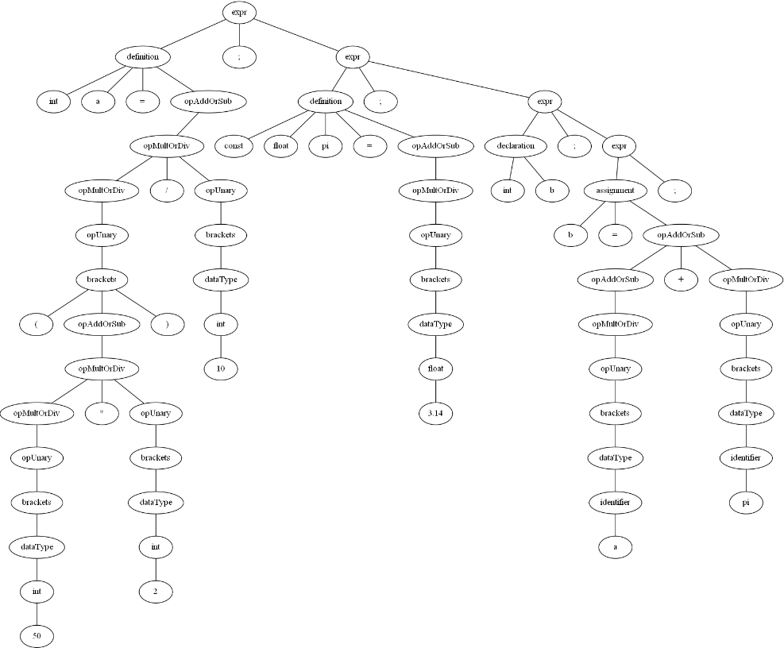
CST
Big tree
A lot of information
Shows how the tokens got parsed
DOT format

Slide 6
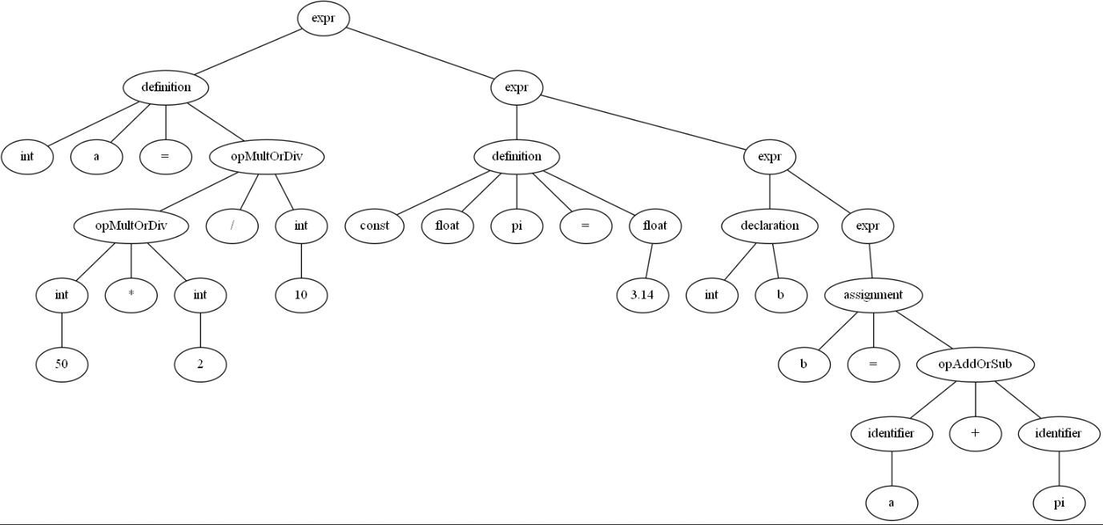
AST
Only useful information
Small tree
DOT format

Slide 7
Symbol table
Name of variable
Datatype
Const or not
Name
Type
Const
test
int
False

Slide 8
Semantic analysis
Redefinition Error
Redeclaration Error
Undeclared variable Error
Reassignment of const variable Error

Slide 9
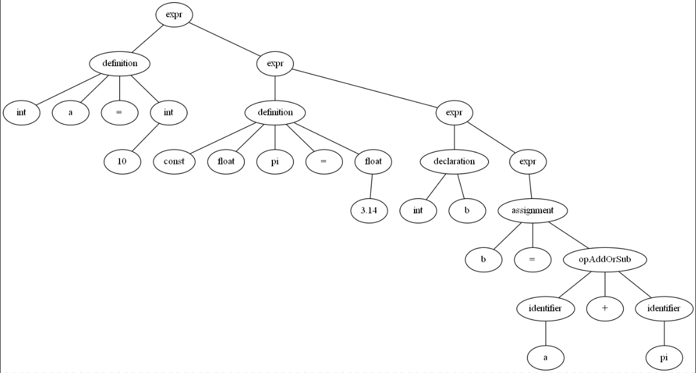
Constant folding
Optimize AST
Saves time and work
Faster

Slide 10
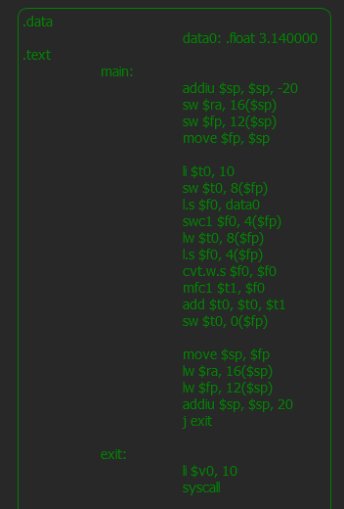
Conversion to mips
Data section
Text section
Main
Stack frame
Exit

Slide 11
compiler structure
Lexer
Parser
CST
AST
Symbol table
Semantic Errors
Constant Folding
Convert to mips

Slide 12
Het Einde
Nog een kleine demo

